Slide 1
SmartFind Express – Simplified Absence approvals

Slide 2
New Simplified and flexible Absence approval setup
SmartFind Express now supports a new and simplified way to set up Absence approval routes, for Admins/Operators to approves Employee absences
SFE has launched “Used-based Absence approvals” to add to existing Location-based based and Absence approval user groups as Absence routing methods
The new feature is optional and can be configured based on the requirements of the school district
All the three methods can be used as needed while configuring absence approvals on the reason
Further simplification and improvements are planned to make Absence approvals very easy to set up and use.

Slide 3
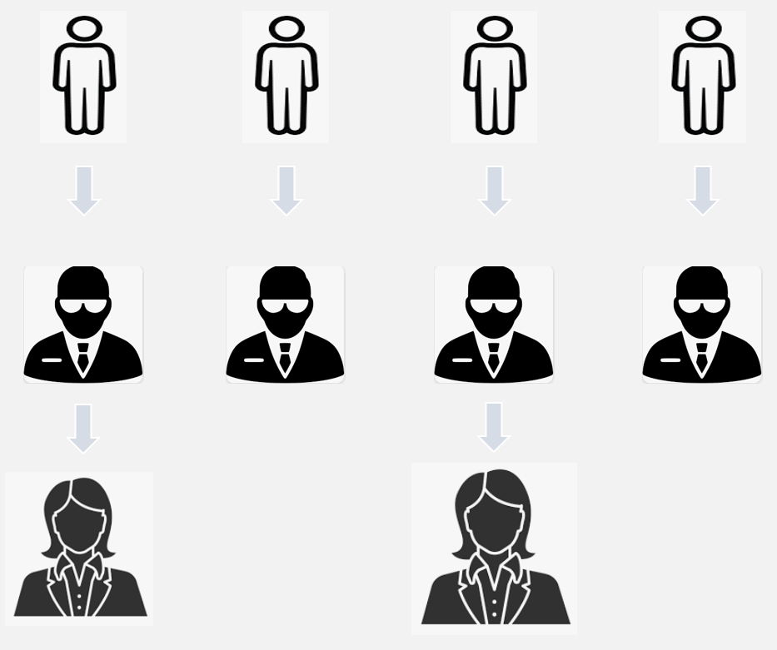
User based Absence approval routing
Employees creating absences needing Admin approvals
Administrators can be configured as approvers on employee profiles
One or more Admins can be configured on individual levels of approvals, based on District requirements
Based on selected method of Absence approval routing , approval will be routed properly to configured Admins
Level 1 Approving Admins based on Employee profiles
Next Level Approving Admins based on Employee profiles

Slide 4
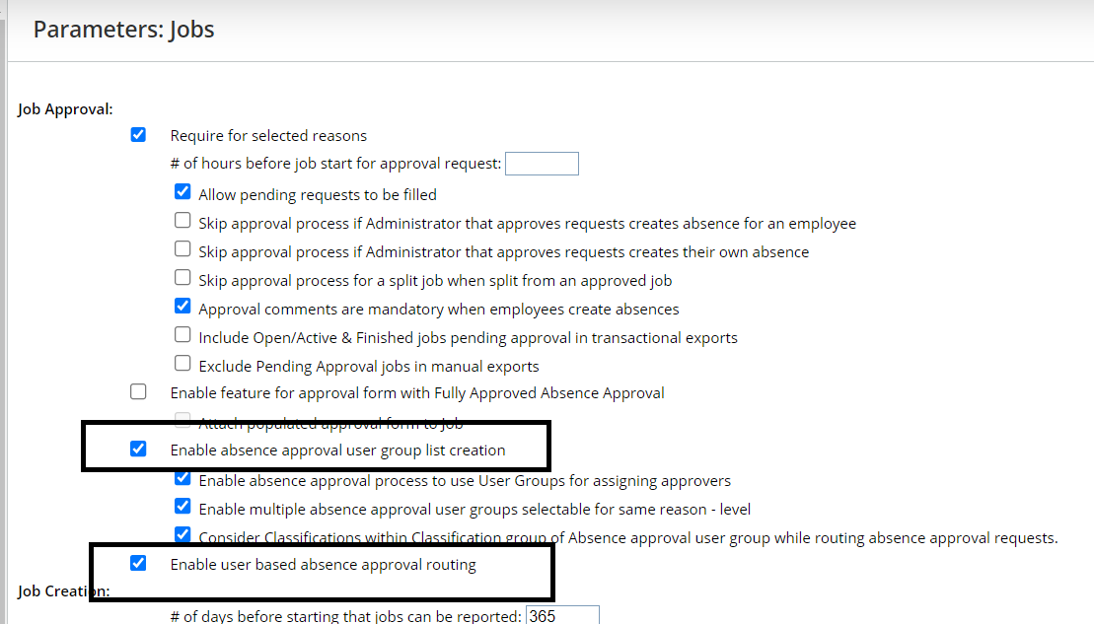
How to turn on and user Absence approval routing methods
Parameter to turn on Absence approval user groups based Absence routing
Parameter to turn on User based absence approval routing

Slide 5
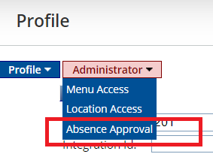
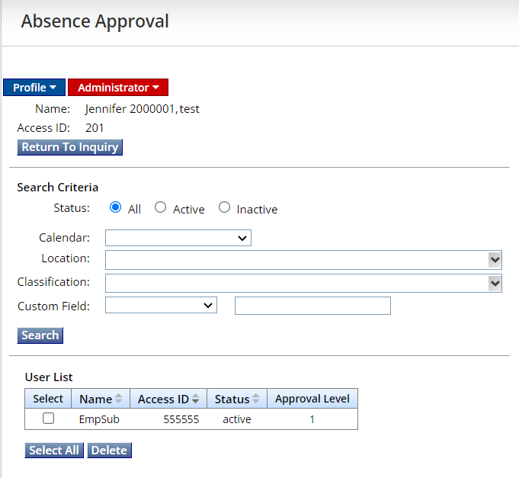
How to select employees under approving Administrator
Employees can be searched and added to Admins profiles from the Absence approval tab. This Admin will be configured as Approving admin for the selected employees
New ‘Absence approval’ tab on Admin tabs to add Employees for which that Admin would be the approver

Slide 6
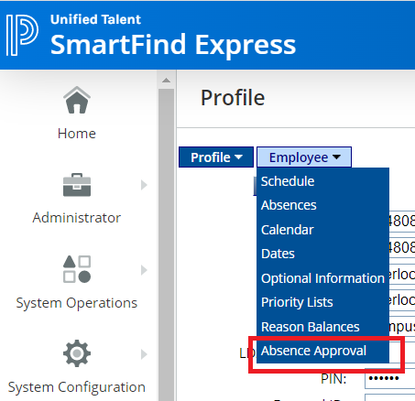
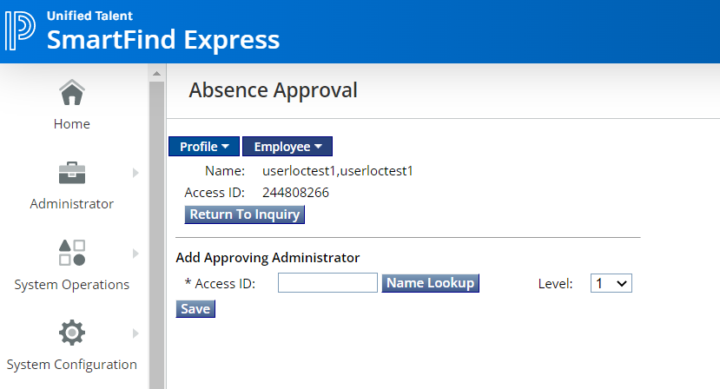
How to select approving Administrator under Employee profile
Admins can be searched and added to the Employee’s profile from the Absence approval tab. This Admin will be configured as Approving admin for the employee
New ‘Absence approval’ tab on Employee tabs to add approving Admins on the employee profile

Slide 7
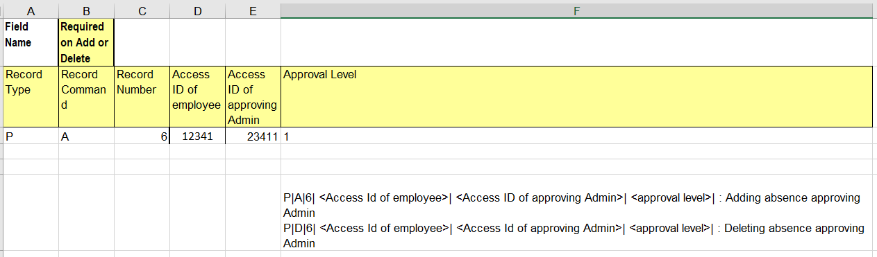
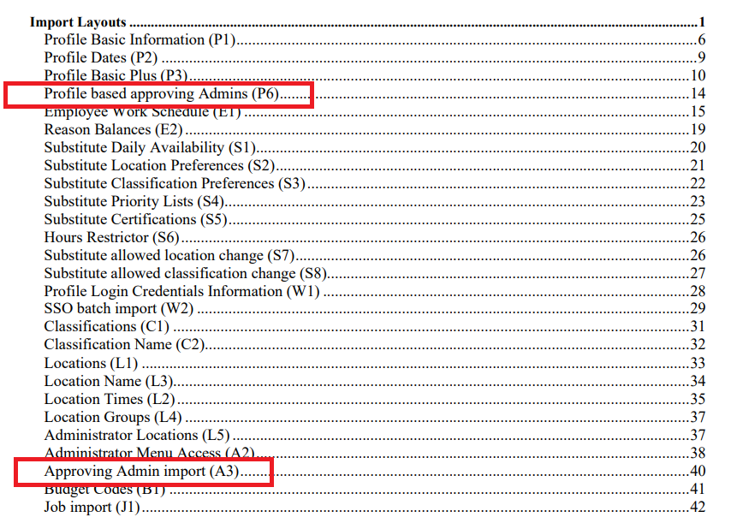
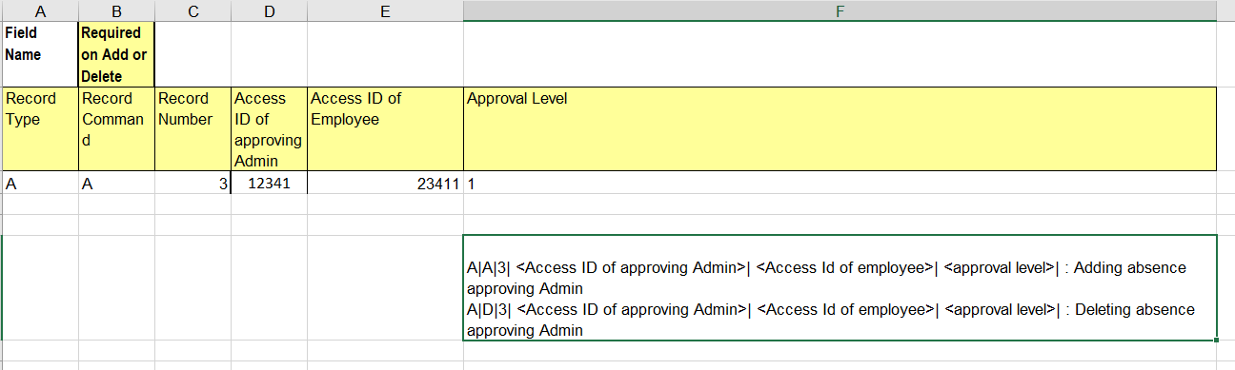
How to configure User based approving Admins through Imports – Mass updates
Import layout guide has been updated with these new import formats
Example of P6 import as shown in updated Import templates
Example of A3 import as shown in updated Import templates

Slide 8
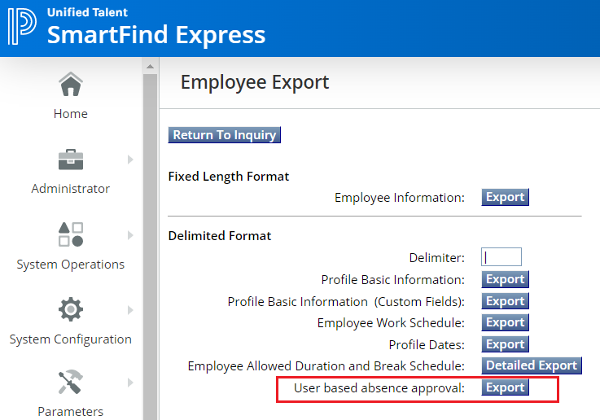
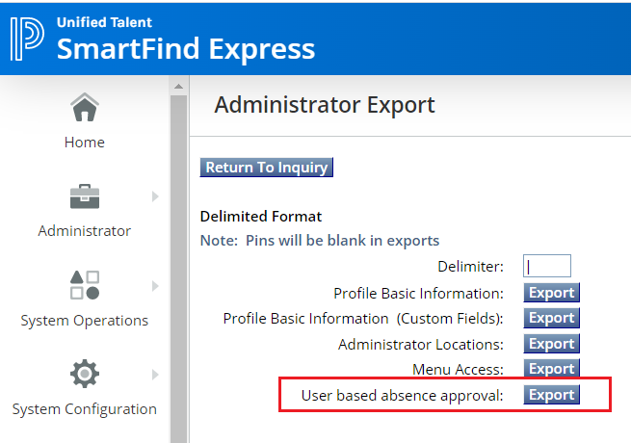
(Coming in March release – Export of approving Admins data in the import format to make Importing easier)
This will export the current data on approving Admins on employee profiles in the Import format of P6
This will export the current data on approving Admins on employee profiles in the Import format of A3

Slide 9
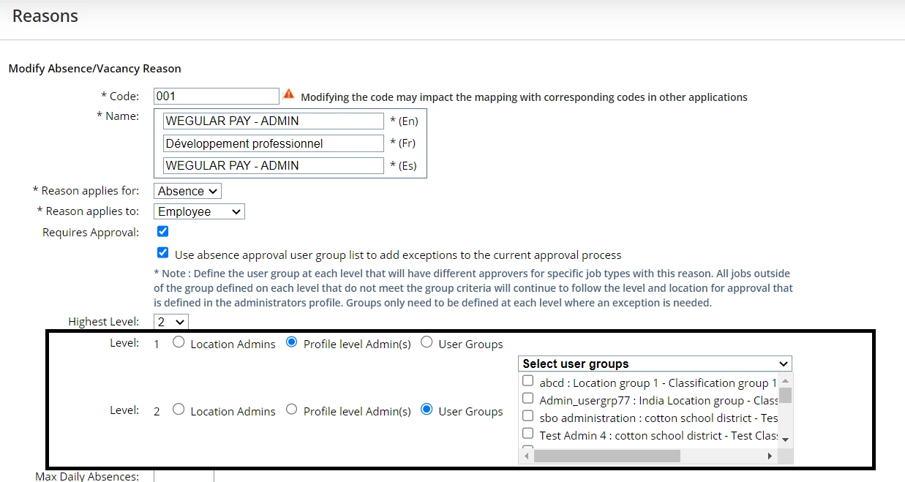
How to configure User Absence approval routing on the Reason
Based on Absence approval routing methods used, radio buttons will show up on Reason configuration
Based on District needs, different approval routing methods can be used on different levels

